Slide 1

FAANG Stock Analysis – Imon Ghosh

Slide 2
Case Study
Research Objective
Analysis
Findings
FAANG Open-High-Low-Close Charts
FAANG price returns for the time period 02-01-2020 to 26-03-2021
Trading Signals
Number of Favorable Days to Buy/Sell/Hold
CONTENTS

Slide 3
Case Study
FAANG is an acronym referring to the stocks of the five most prominent and best-performing American technology companies: Facebook, Amazon, Apple, Netflix and Alphabet (formerly known as Google).
The case study consists of five datasets.
Each dataset contains the stock price data for each of the companies for the last 5 years (from 2016 to date).

Slide 4

Research Objective
The purpose of this research project is to analyze the stock price data to determine trading strategies – Buy/Sell/Hold, on the basis of moving averages calculated for a period of 10 days (short term) and 30 days (long term).
Determine the price returns for each stock for the time period 02-01-2020 to 26-03-2021.

Slide 5

Analysis
The following has been done based on the data provided for the five stocks :
Determined the trade signals based on the short-term and long-term moving averages.
Published the findings based on the stock data analysis.

Slide 6
Findings
The best predictions to Buy and Sell FAANG stocks for the time period 28-03-2016 to 26-03-2021 have been presented below:
Facebook : Buy - 23-05-2016 at closing price $115.97
Sell - 02-12-2020 at closing price $287.51
2. Amazon : Buy - 06-05-2016 at closing price $673.95
Sell - 05-11-2020 at closing price $3322.0
Apple : Buy - 20-06-2016 at closing price $23.77
Sell - 19-02-2021 at closing price $129.87

Slide 7
Netflix : Buy - 19-07-2016 at closing price $85.84
Sell - 20-01-2021 at closing price $586.34
Google : Buy - 16-06-2016 at closing price $710.36
Sell - 16-03-2021 at closing price $2092.52
The maximum price returns for the FAANG stocks, for the time period 02-01-2020 to 26-03-2021, has been from Apple Inc. The stock has returned 63.66% over the time period that has been considered.

Slide 8
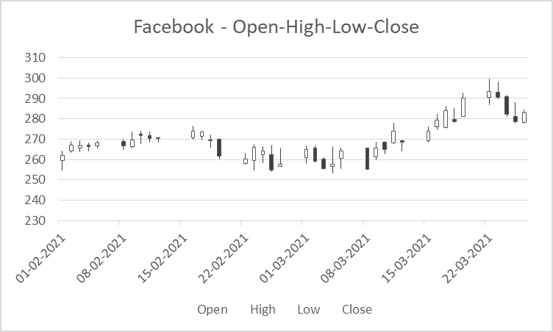
FAANG Open-High-Low-Close Charts

Slide 9
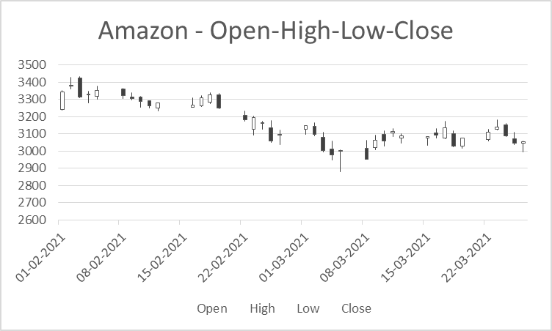

Slide 10
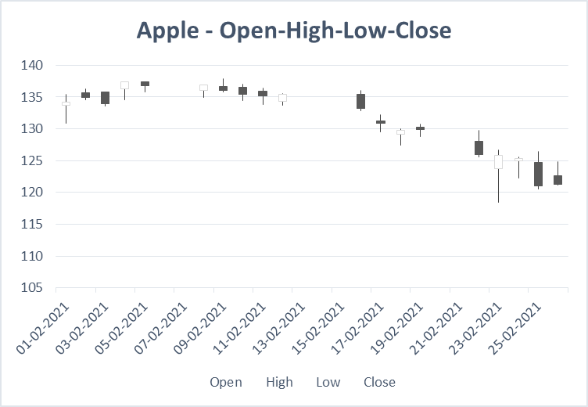

Slide 11
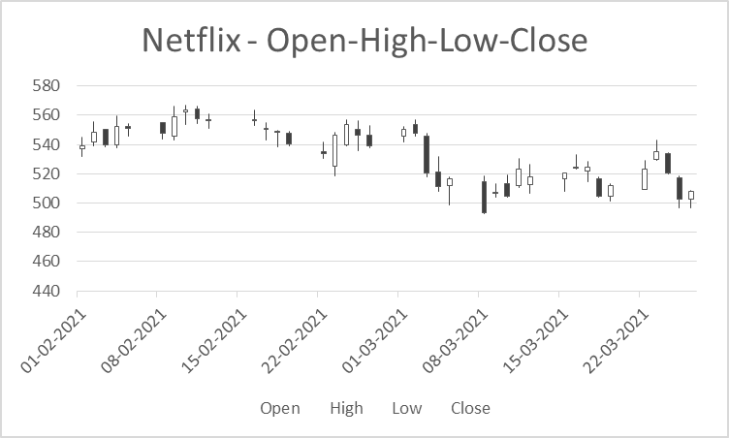

Slide 12
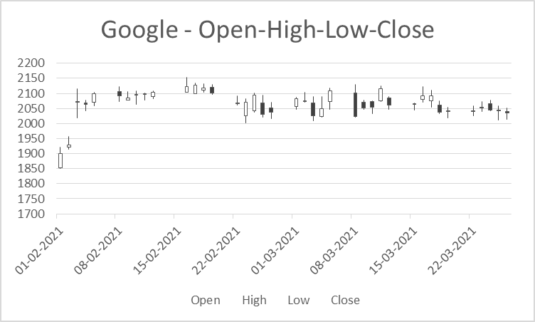

Slide 13
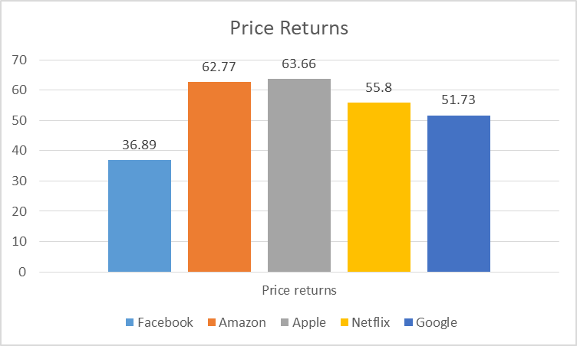
FAANG price returns for the time period 02-01-2020 to 26-03-2021

Slide 14
The price returns has been calculated using the formula : (End Value – Initial Value) / Initial Value
In this case, we have considered the opening price and the closing price for the time period 02-01-2020 to 26-03-2021. Then we have plugged in the maximum closing price for as end value and minimum opening price for initial value to the formula mentioned above.
Amongst the FAANG stocks, Apple, Inc. has delivered the highest return, 63.66%, over the time period that has been considered. On the other hand, Facebook has delivered the lowest return, 36.89%

Slide 15
Trading Signals
When the short-term moving average (10 - days) crosses above the long-term moving average (30-days), it is a signal to BUY, as it indicates that the trend is shifting up.
On the other hand, when the shorter term moving average crosses below the longer term moving average, it is a signal to SELL, as it indicates the trend is shifting down.
When the signal is neither buy nor sell, it is classified as hold. If you already own the stock, keep it and if you don't then don't buy it now.

Slide 16
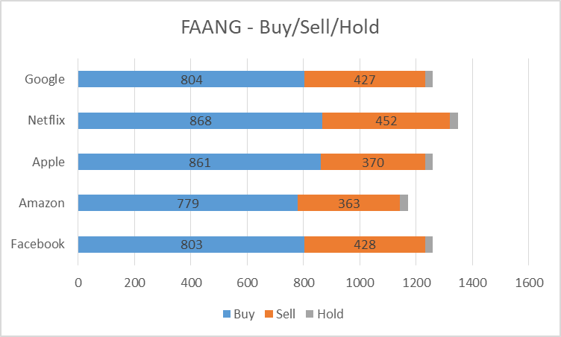
Number of Favorable Days to Buy/Sell/Hold
Netflix stock has the highest number of favorable days to buy and sell.
Amazon has the least number of favorable cases for buy and sell.

Slide 17
Thank You

